Slide 1

DL 3
Implementing and deploying models
CNNs, GPUs, FP ops, autograd, GUI
Colab link

Slide 2
Do this on your computer (For GUI later)
Python 3.8 - Python 3.11
Create new virtual environment (optional)
Run in command line:
pip install streamlit numpy
pip install torch opencv-python streamlit_drawable_canvas
If successful, test with
streamlit hello
Browser should pop-up, means correctly installed

Slide 3
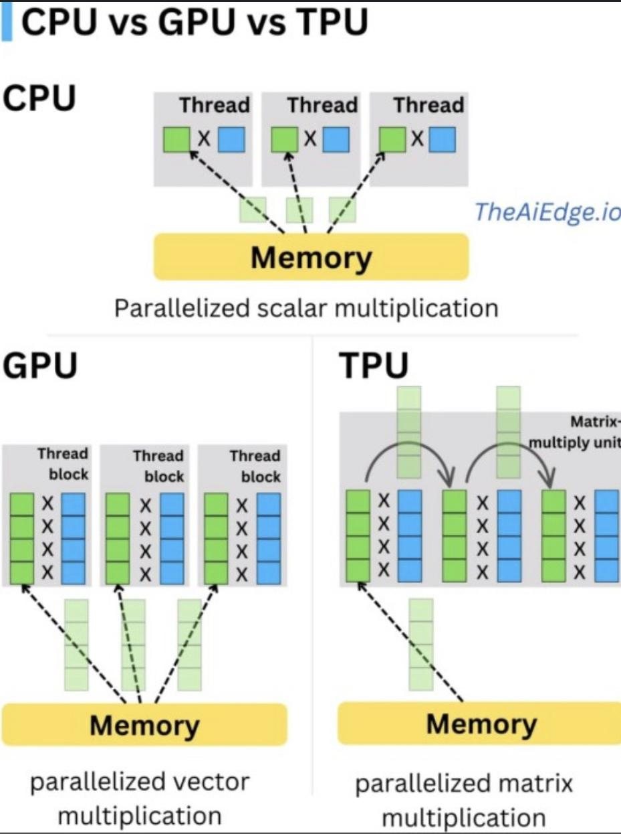
Made with graphics processing in mind
Faster for parallelised vector arithmetic

Slide 4
CUDA
Nvidia calls its parallel processing platform CUDA. While CUDA Cores are the processing units inside a GPU.
CUDA is an abbreviation for Compute Unified Device Architecture. It is a name given to the parallel processing platform and API which is used to access the Nvidia GPUs instruction set directly.

Slide 5
How to get compute
Purchase - Lambda labs(ssh)/google colab
Use school’s - apply for school’s 3090 (ssh)
Buy your own - nvidia gpu
Slow upload/download

Slide 6
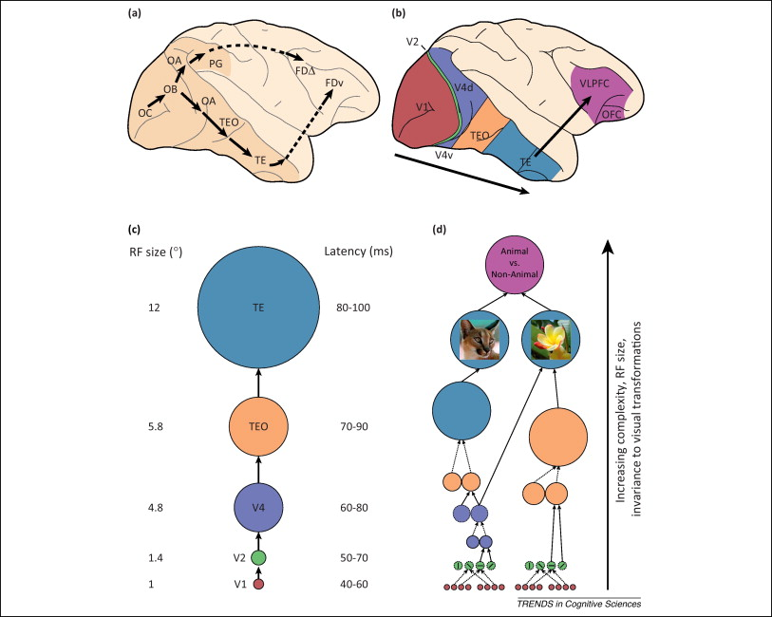
How do we see and understand?
For more info:
Stilwell brain by Vsauce
on youtube

Slide 7
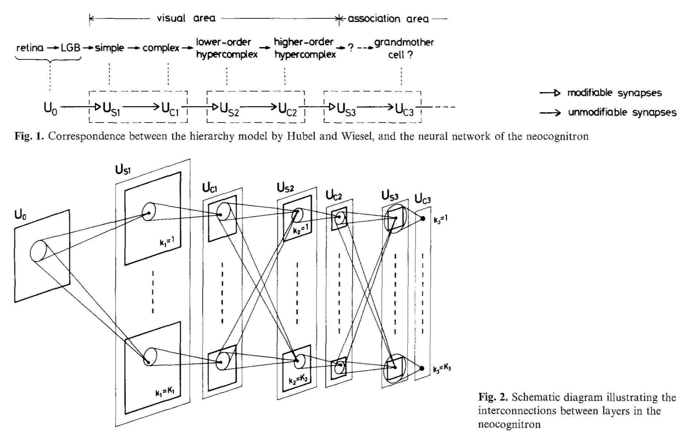
Scientists created convolution layers with inspiration from primate image pathways
Fukushima K (1980), and Hubel, D. H., & Wiesel, T. N. (1962)

Slide 8
Conv layers
Conv layer of
Input Shape : (3, 7, 7)
Output Shape : (2, 3, 3)
Params:
K : (3, 3) — P : (1, 1) — S : (2, 2) — D : (2, 2)
Image credits: Axel Thevenot

Slide 9
Why conv
-Parameter Efficiency: Convolutional layers require fewer parameters than fully connected layers. This is because they use a small filter that slides across the input data, sharing weights across all positions in the input, whereas fully connected layers connect every input unit to every output unit.
-Spatial Hierarchies: Convolutional layers are adept at learning hierarchical spatial patterns from input data, making them ideal for image processing and computer vision tasks.
-Translation Invariance: Due to the weight sharing and local receptive fields, convolutional networks are somewhat invariant to the translation of input features.

Slide 10
Pytorch Autograd
-Behaves like a stack, first in last out
-Gradient is accumulated
-Need to call .zero_grad() to clear gradients every pass

Slide 11
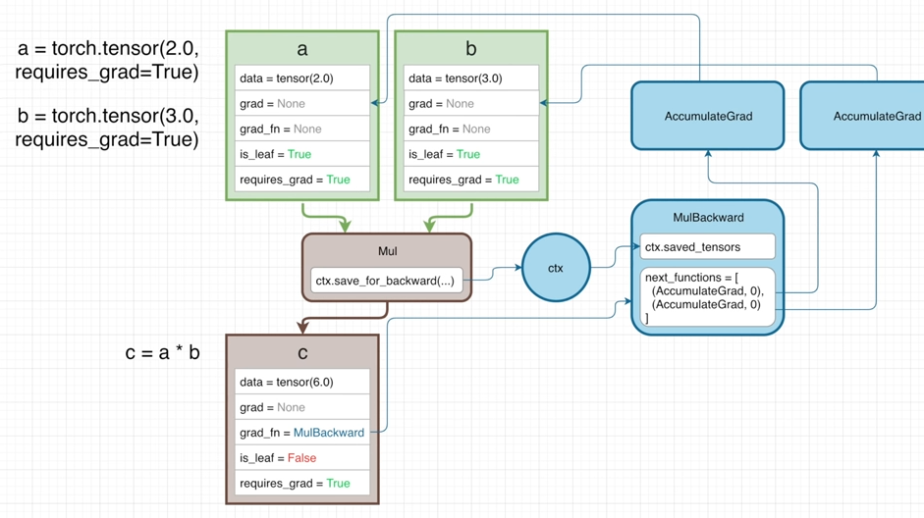
Gradient calculation
Object that are used to retain information during the forward pass that can be used later in the backward pass to compute gradients
gradients calculated for each operation are passed to AccumulateGrad
During backprop, grad of tensor = Accumulategrad

Slide 12
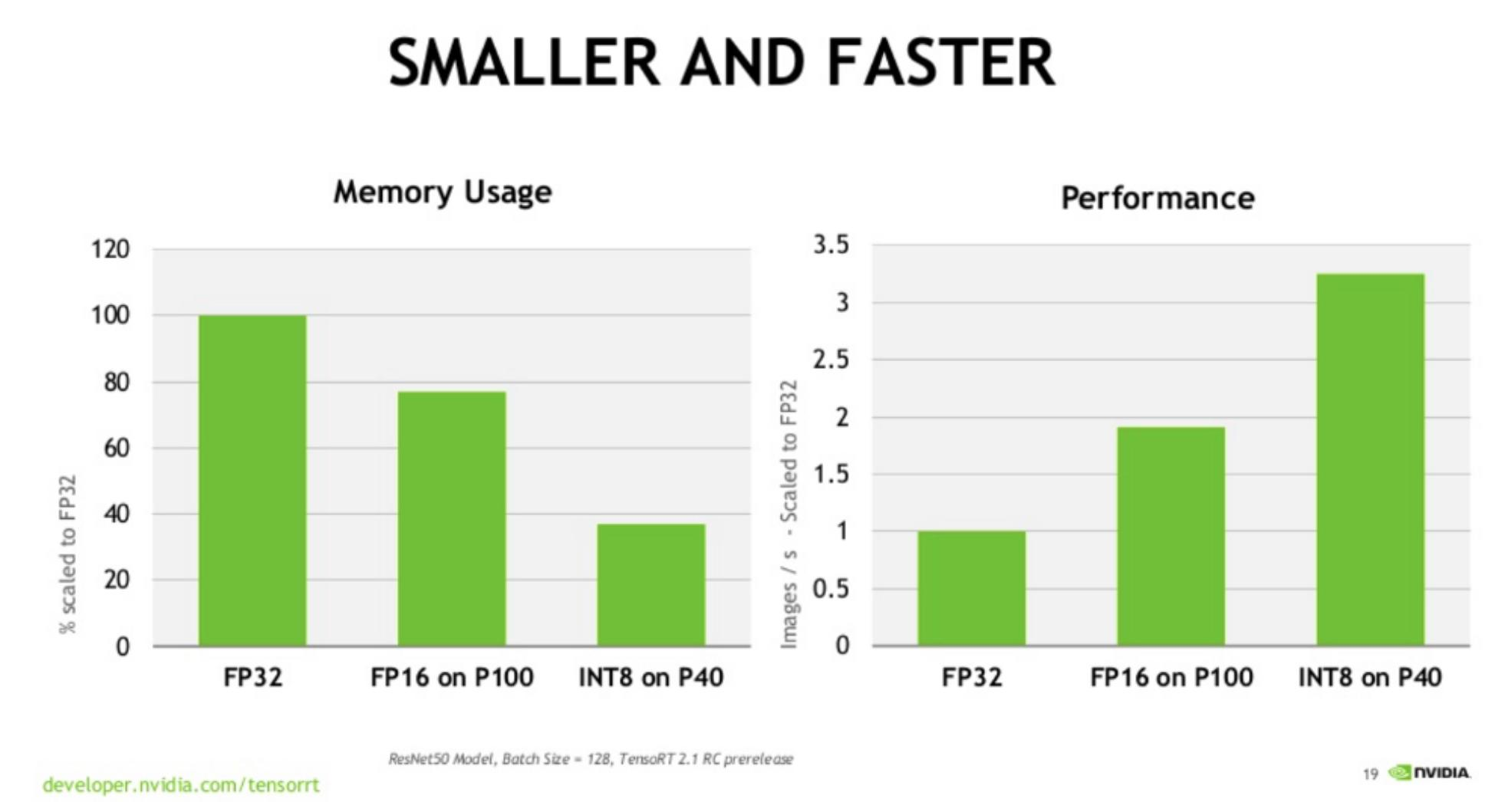
FP calculations
-Which is easier to calculate? 0.16 x 0.18 or 0.1623823489 x 0.1817234234?
-More compute required to calculate, more storage required to store
-Not important for small models but crucial for larger models

Slide 13
Why learn tensorflow when I know pytorch?
-Some companies use TF/Keras, some projects are easier when done in TF (Some NLP ones), simpler
-Not really necessary
-Personal preference

Slide 14
Python GUIs
-Streamlit and gradio
-Allows easy integration between python programs,API with a front-end
-Simple to use/install, and to deploy
-Perfect for projects/hackathons

Slide 15

Bridges python and React
create new directory with either file explorer/mkdir for this, cd into it
Create new .py file and open in code editor
Streamlit code will be in this file
streamlit run <filename>.py will run this and produce a pop-up like what happen after streamlit hello

Slide 16
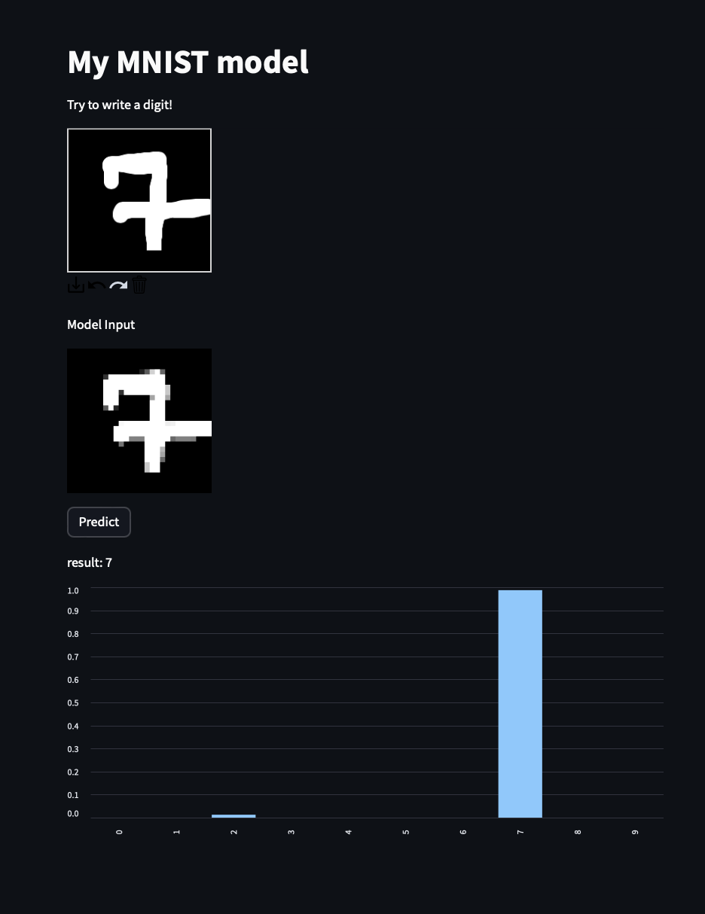
Text
User input canvas
Processed input
Model output

Slide 17
Try implementing cifar with Streamlit
Can use st.file_uploader(

